Slide 1

IBM SkillsBuild Decoding Data PBL Program 2025 Final Project Presentation
Project Name : STUDENT PERFORMANCE ANALYSIS Team Name : DATA DREAMERS
College Name : GURU NANAK INSTITUTE OF TECHNOLOGY,KOLKATA

Slide 2
TEAM MEMBERS
MEMBER 1: RITTIKA SAMANTA
EMAIL ID : rittikasamant03@gmail.com
MEMBER 2: RITIKA DEY
EMAIL ID: ritikadeybalsi@gmail.com
MEMBER 3: RISHITA ROY
EMAIL ID: royrishita0420@gmail.com
MEMBER 4: SANCHITA GUHA
EMAIL ID: sanchitaguha169@gmail.com

Slide 3
INTRODUCTION
Overview of the Project
Our project focuses on analyzing students' academic scores to uncover performance trends and patterns. The aim is to build a Power BI dashboard that gives clear insights into how students perform across different subjects, genders, and groups.
Objective
Analyze academic performance using exam scores from the given dataset.
Clean and organize the raw dataset for analysis.
Compute key metrics such as average, highest, and lowest scores.
Visualize data with bar and column charts to show trends in subject-wise and gender-wise performance.
Enable interactivity using Power BI slicers, allowing users to filter data by class or gender.

Slide 4
PROBLEM IDENTIFICATION
Problem Statement
There is a need to analyze students' academic performance data to identify patterns and disparities based on subjects, gender, and class. Without this analysis, educators may miss opportunities to support underperforming groups or improve teaching strategies.
Significance of the Problem
Helps identify subject-specific weaknesses and performance gaps between genders and class groups.
Supports data-driven decision making for teachers, school administrators, and policymakers.
Encourages personalized learning approaches by understanding how different groups of students perform.
Relevant SDGs
SDG 4 – Quality Education: This project directly supports efforts to ensure inclusive and equitable quality education and promote lifelong learning opportunities by using data analytics to enhance academic performance and equality in education.
SDG 5 – Gender Equality: By analyzing gender-wise performance, the project helps in identifying and addressing gender disparities in education outcomes.

Slide 5
DATA COLLECTION
Sources of Data
LINK :- https://www.kaggle.com/datasets/spscientist/students-performance-in-exams
Data Description
The dataset contains information about students' academic performance in various subjects.
Typical attributes (columns) in this dataset include:
Gender
Parental level of education
Lunch type
Test preparation
Course completion
Scores in Math, Reading, and Writing
Each row represents a student's performance record.
Data Collection Methods
Although the dataset is obtained from Kaggle, its original source suggests:
Survey-Based Collection: Likely gathered through structured surveys or academic records from educational institutions.
Manual Entry: Data was probably manually entered or compiled into a structured format for public use.

Slide 6
DATA PREPROCESSING
Data Cleaning Methods
Removing Duplicates: Checked for duplicate student records and removed them.
Standardizing Categorical Values: Ensured consistency in entries like: "female" vs "Female" → Converted all the fields to Capitalize to provide consistency and to bring uniform formatting among all.
Checking for Outliers: Verified that scores in Math, Reading, and Writing are within 0–100.
Trimming White Spaces: Removed leading/trailing whitespaces as per need in text fields (e.g., gender, lunch).
Handling Missing Values
Detecting Missing Values: Used .isnull() in Python (Pandas) for checking nulls.
Imputation Techniques Used:
Numerical Fields (Scores): Filled the missing scores using mean, median, or mode depending on the distribution.
Categorical Fields (e.g., gender, lunch type): Used mode imputation for most frequent category.
In the columns with many missing values, filled it with "Unknown".
Data Transformation Techniques
Feature Engineering: Created three new columns :
Total = Math + Reading + Writing
Average = (Math + Reading + Writing) / 3
Performance = High / Medium / Low based on binning average scores.
Binning: Convert numerical scores into categorical bins (e.g., 0–50 = Poor, 51–75 = Average, 76–100 = Excellent).

Slide 7
DATA ANALYSIS
Analytical Tools Used
Microsoft Power BI: For interactive dashboards, visualizations (bar/column charts, slicers, filters), Data wrangling, visualization, and statistical computation.
Microsoft Excel / Google Sheets: For initial data exploration, cleaning, and quick summary statistics.
Methods Used
Group-wise Aggregation: Performance comparison by gender, test preparation status, or parental education.
Data Visualization: 1) Bar charts for average scores by gender and subject
2) Column charts for performance based on gender, race/ethnicity based on subjects
3) Slicers for race, gender, subject and test preparation filters (in Power BI).
Trend & Distribution Analysis: Uses line chart to show how scores are spread across categories.
Key Findings and Insights Derived
Gender-Based Performance: Females often outperform males in reading and writing, while males and females score almost similar in maths.
Impact of Test Preparation: Students who completed the test preparation course consistently perform better across all subjects.
Influence of Race/Ethnicity: Group E students have higher average scores in each subject than other groups.
Subject-Wise Trends: Students tend to score highest in reading, followed by writing, with math having the lowest average
Performance Disparities: There is noticeable variance in performance across gender.

Slide 8
HYPOTHESIS DEVELOPMENT
Formulated Hypothesis
Students who completed the test preparation course scored significantly higher in math, reading, and writing exams than those who did not.
Rationale Behind the Hypothesis
Observed Trends in education reports indicate that structured preparation leads to better exam outcomes.
The dataset includes a variable for test preparation which is course completion, making it possible to compare the performance between the two groups.
Understanding the impact of test preparation can help schools decide whether to invest more in preparatory programs or personalized coaching.
Method for Testing the Hypothesis
1. Data Segmentation:
Divide students into two groups based on the test preparation course variable:
Group A: Completed the course
Group B: Did not complete the course
2. Statistical Testing:
Null Hypothesis (H₀): There is no difference in average scores between the two groups.
Alternative Hypothesis (H₁): There is a significant difference in average scores between the two groups.
3. Visualization:
Used bar charts to visualize the score differences between the two groups.
Add confidence intervals to support visual inference.

Slide 9
SOLUTION DESIGN
Proposed Solution
Leveraging the data-driven insights from student performance analytics we can :
Identify the underperforming groups (by gender, subject, or preparation course status).
Target the academic interventions such as additional classes, tutoring, or improved test preparation programs.
Promote some personalized learning by grouping students based on performance patterns.
Empower educators and institutions with tools (Power BI dashboards) to track and respond to trends in real time.
Implementation Plan
1. Data Preparation: Clean, transform, and validate data (remove errors, handle missing values, format categories) using Excel, Python (Pandas), Power BI
2. Analysis & Visualization: Perform statistical analysis (t-tests), build subject-wise performance dashboards using Power BI, Seaborn/Matplotlib
3. Insight Derivation: Identify gaps by test prep, gender, subject; highlight strengths & weaknesses using Power BI visuals (bar, boxplot, cards)
4. Action Plan: Share findings with teachers/administrators, propose interventions (e.g., mandatory prep courses) by creating Reports and holding Stakeholder meetings
5. Monitoring & Feedback: Track improvements using updated dashboards and refine strategy
Alignment with SDGs
SDG 4 – Quality Education: Enables equitable access to performance data, promoting data-driven strategies for better learning outcomes and improved education quality.
SDG 5 – Gender Equality: Highlights gender-based performance gaps, helping address academic inequalities through interventions.

Slide 10
VISUALIZATION
Prominent features of the platform
Interactive Dashboard: Users can dynamically filter data by gender, class, test preparation, or race/ethnicity.
Subject-wise Performance Analysis: Visual insights on Math, Reading, and Writing scores separately, using bar/column charts and line charts.
Average Score Tracker: Real-time computation and display of mean/median scores across demographic groups.
Comparative Visuals: Side-by-side comparison of students with and without test preparation courses.
Trend & Distribution Analysis: Line charts showing score distribution over different student groups.
Performance Segmentation: Students are classified into Excellent / Average / Poor performers using average or total scores.
Smart Filtering with Slicers: Easily segment data based on gender, subject, or performance band.
Exportable Reports: Capability to export PDF or Excel summaries for teachers or admin use.
Site Map
Home Page
│
├── Dashboard Overview
│ ├── Total Students, Score Range
│ ├── Subject-wise Avg Scores (Math / Reading / Writing)
│ ├── Gender-Based Performance Chart
│ └── Test Prep Impact Summary
│
├── Deep Dive Analysis
│ ├── Filter by: Gender | Class
│ └── Performance Segments (Excellent/ Average / Poor)
│
├── Insights & Recommendations
│ ├── Key Findings from Analysis
│ ├── Suggested Interventions
│ └── SDG Alignment Summary (Quality Education, Gender Equality)
│
├── Data & Methodology
│ ├── Dataset Description
│ ├── Cleaning & Transformation Techniques
│ └── Hypothesis Testing Results (p-values, conclusions)
│
└── Export / Download Section
├── Export Reports (.PDF / .CSV)
├── Print Dashboard Snapshot

Slide 11
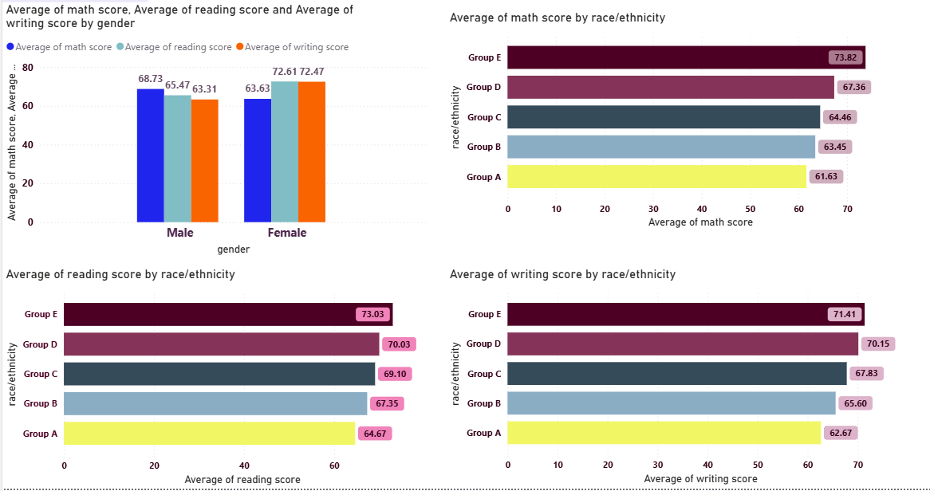
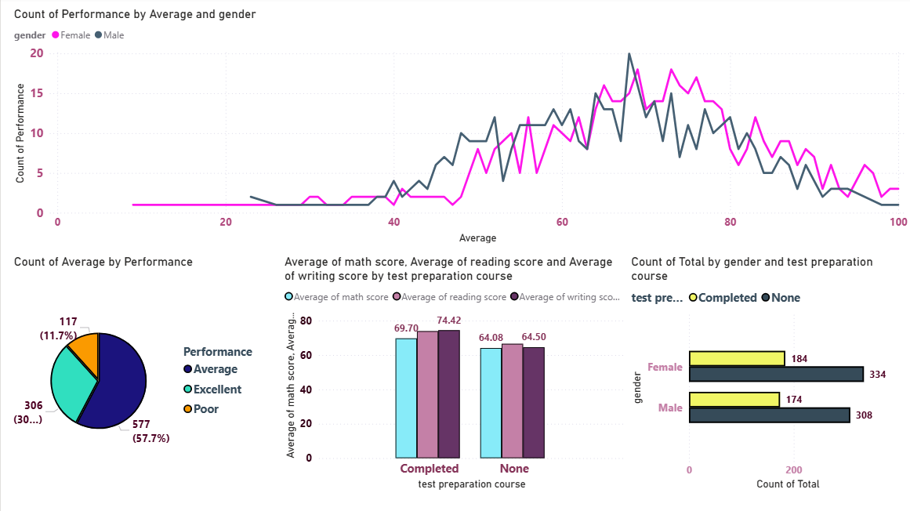
CONCLUSION
Screenshot of the webpage

Slide 12
CONCLUSION
Impact of Proposed Solution
The Student Performance Analysis project successfully demonstrates how data analytics can transform educational insights into actionable strategies. By leveraging data from a structured student dataset, we explored the impact of demographic factors and preparatory efforts on academic outcomes in Math, Reading, and Writing.
Through descriptive statistics, visualizations, and hypothesis testing, we identified significant performance trends:
Students who completed test preparation courses consistently outperformed those who did not.
Gender-based performance gaps were evident, particularly with females excelling in reading and writing, while males showed slightly stronger math scores.
Race/Ethnicity also correlated with academic performance, revealing important socio-educational dynamics.
The interactive Power BI dashboard built as part of this project enables stakeholders—teachers, school administrators, and policymakers—to monitor, explore, and act on performance data with ease. It promotes data-driven decision-making and encourages targeted interventions for student improvement.
Aligned with UN Sustainable Development Goals (SDGs), particularly: SDG 4 – Quality Education and SDG 5 – Gender Equality this project supports the global mission of making education more inclusive, equitable, and effective.
Future Work
Moving forward, this solution can be enhanced by:
Integrating real-time academic systems for live tracking,
Applying predictive models for student performance forecasting,
Generating automated student profile reports for parents and teachers,
Expanding to benchmark performances across schools and regions.
In conclusion, this project not only provides a strong foundation for academic performance monitoring but also offers a scalable framework for improving learning outcomes across diverse educational contexts.

Slide 13
REFERENCES
Tools and Software Used
GOOGLE SHEETS
.csv DATASET FILE
MICROSOFT POWER BI
Additional References
https://www.kaggle.com/datasets/spscientist/students-performance-in-exams

